Slide 1
Overlap syndrome (OSA-COPD) evidence review

Slide 2
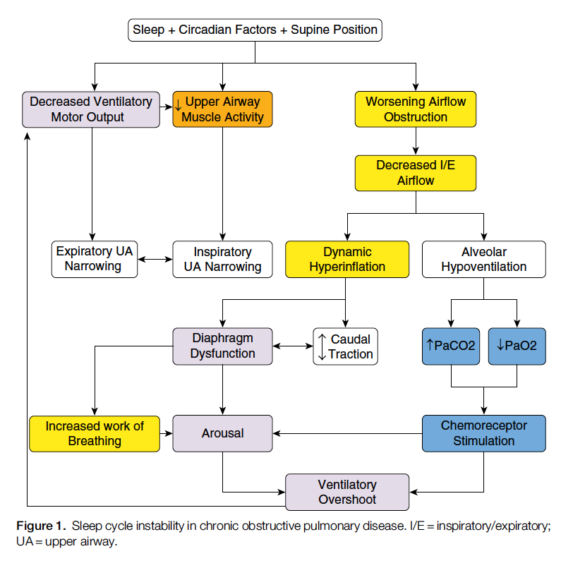
123: Malhotra A, Schwartz AR, Schneider H, et al. Research priorities in pathophysiology for sleep-disordered breathing in patients with chronic obstructive pulmonary disease. An official American Thoracic Society research statement. Am J Respir Crit Care Med 2018; 197: 289–299.
”Overlap syndrome” – where does this term come from? ***
No definitive evidence of increased incidence beyond what is expected by two common conditions. (26, 27) – most evidence only pertains to mild COPD though
Both conditions are increasing – right? – due to aging population, historical smoking trends, obesity
However, the traditional definition of OSA (based on AHI) may not adequately capture the disordered breathing in COPD, particularly as increased upper airways resistance, hypoventilation, (+/- REM hypoxemia) and sleep fragmentation may occur independent of hypopneas and apneas. [citation 20]
This disorder sleep, in turn, can worsen daytime HRQOL – increased time in bed, more naps
Pathophysiology: smoking, rostral fluid shift, upper airway muscle weakness, inhaled corticosteroids.
Loss of drive to breath -> increased airflow resistance, decreased load compensation => hypoventilation. While not causing apnea, this may lead to systemic effects where similarly severe OSA (by AHI) would not -> thus, the COPD ‘enables’ deleterious effects of OSA (normal gas exchange can occur in healthy individuals, but can’t in COPD due to unmasking of some of the ways that the body compensates
Emphysema: protective due to traction that occurs with dynamic hyperinflation.
Notes:
In sum, the diseases co-occur at roughly their expected rates. However, the pathophysiology of the two (OSA vs OVS) may differ enough that effects are heterogenous and that the two are not truly independent (some patients would not have OSA, were it not for their COPD; some patients only have OSA because of their COPD – these two roughly cancel. Additionally, OSA does not seem to create as clearly a defined syndrome as in the case of non-COPD indivuals: instead, the diagnostic criteria exist on a spectrum with sleep hypoventilation, poor sleep architecture, and other gas exchagnge abnormalities – thus, it remains to be seen if the current conception of OSA is valuable in this case). Importantly, the consequences of co-occurrence appears synergistic – particularly with respect to CV outcomes, readmissions, etc.

Slide 3
Adler D, Bailly S, Benmerad M, Joyeux-Faure M, Jullian-Desayes I, Soccal PM, et al. (2020) Clinical presentation and comorbidities of obstructive sleep apnea-COPD overlap syndrome. PLoS ONE 15(7): e0235331. https://doi.org/10.1371/journal.pone.0235331 https://www.ncbi.nlm.nih.gov/pmc/articles/PMC7347183/pdf/pone.0235331.pdf
OVS: less snoring, morning headaches, and EDS including sleepiness while driving.
More common nocturia.
OVS has more comorbidities (HLD, HTN, Stroke, CAD/MI, PVD, CHF) – largely mediated by increased smoking.
Leads to more profound hypoxemia, higher Risk of pHTN and right heart failure.
Description of pathophysiology:
However: Overlap syndrome is actually a mix of separate pathophysiology: OSA, CSA, worsening airflow obstruction, hypoventilation, oxygen desaturation, and sleep fragmentation. - often a conflation of SDB and ‘OSA’, though there are some shared pathophysiologic constraints.
NREM: increased upper airway resistance, impaired load compensation, blunted chemosensitivity
REM: propensity for upper airway collapse and hypovenlation related to skeletal muscle atonia (loss of rib cage intercostal muscle contribution to ventilation.
Likely have different manifestations in COPD vs OSA.
Notes:
Particular limitations of the AHI in the case of overlap syndrome: hypopneas – duration of hypoxemia is not considered, arousals for other reasons (cough, poor quality sleep, hyperinflation) lead to irregular breathing patterns that meet the criteria for hypopneas, active smokers have misleading SpO2 values that may mask clinically important hypopneas.
COPD specific abnormalities:
Expiratory snoring associated with flow limitation:
52. Alchakaki A, Riehani A, Shikh-Hamdon M, Mina N, Badr MS, Sankari A.
Expiratory snoring predicts obstructive pulmonary disease in patients
with sleep-disordered breathing. Ann Am Thorac Soc 2016;13:86–92.
53. Owens RL, Edwards BA, Malhotra A, Wellman A. Expiratory resistance
increases end-expiratory lung volume during sleep. Am J Respir Crit
Care Med 2012;185:e10–e11.
Dynamic hyperinflation Figures E2-4 supp.ement.

Slide 9
Pathogenesis of obstructive sleep apnea in individuals with the COPD + OSA Overlap syndrome versus OSA alone Physiological Reports. 2020;8:e14371. https://doi.org/10.14814/phy2.14371
OSA pathogenicity:
Anatomic factors: upper airway collapsibility (may stiffen when lung is hyper-inflated, but emphysema loss of elastic recoil may lessen this – hard to know a priori)
Neurologic / Physiologic factors: upper airway muscle response (worsened by ICS? Smoking?), respiratory-related arousability from sleep (may be lower in OVS due to frequent awakenings in the absence of upper airway collapse), control of breathing (respiratory drive generally increased)
Matched OSA (n=15) to OVS (n=15; most with moderate obstruction) on gender, age, BMI. Exclude: narcotics, sedatives, supp O2, recent exacerbation, BMI over 36, active smoking, heavy EtOH
PSG to determine Veupnea, Vpassive and Pcrit, Varousal/ArTh, Loop gain
“Consistent differences in key OSA traits were not observed between OVS and OSA alone.”. OVS: lower sleep efficiency, REM SpO2
Reduced upper airway response in those with air trapping; increased loop gain in those with worse airflow obstruction (contrary to expection; perhaps mediated by hypoxemia?). Somewhat lower arousal threshold – perhaps explains how hypercapnia can occur?
No difference in collapsibility: perhaps this is selection – if you have to have dx of OSA, then by definition the airway must be collapsable
Notes:
“
Veupnea: Ventilation during sleep in the absence of upper
airway obstruction (i.e., on therapeutic CPAP pressure),
such that ventilation should match baseline ventilatory
drive.
Vpassive and Pcrit: Both are measures of collapsibility of
the upper airway, determined at baseline ventilatory
drive (i.e., without accumulation of any additional drive
that might result from prolonged upper airway obstruction).
Vpassive measures ventilation at atmospheric pressure
(zero cm H2O) under such nonactivated airway
conditions, while Pcrit measures the pressure at which
inspiratory flow goes to zero under nonactivated airway
conditions.
Varousal and Ventilatory arousal threshold (ArTh): Both are
measures of the tendency to wake from sleep due to inspiratory
flow limitation. Varousal measures the minimum
ventilation that can be sustained without arousal during
steady-state conditions. Ventilatory drive accumulates
under such conditions, leading to increases in intrathoracic
pressure swings; a high Varousal indicates a tendency
to wake up with minimal increase in intrathoracic pressure
swings. The ArTh is a calculated value, using the LG and
Veupnea data to estimate the ventilatory drive that is present
at the ventilation measured by Varousal.
Vactive and Upper airway gain (UAG): Both are measures
of the ability of the upper airway to dilate in response to
increases in respiratory drive. Vactive measures ventilation
at atmospheric pressure (zero cm H2O) under maximally
tolerated increased respiratory drive (i.e., at the same
point in drive as Varousal and ArTh). The UAG is a calculated
value, using Vpassive, Vactive, Veupnea, and LG to determine
the increase (or decrease) in ventilation achieved
using an increase in respiratory drive.
Loop Gain (LG): Measures instability in ventilatory control,
by measuring the ratio of ventilatory response to a
steady-state ventilatory disturbance. The disturbance is
the increase in drive that results from steady-state inspiratory
flow limitation conditions, and response is determined
by suddenly alleviating the flow limitation.

Slide 10
Non-apnea related hypoventilation in COPD [ ] retool this one – frame this as additive to the deleterious consequences of hypoxemia/hypercapnia. Ie – what are the consequences
Sleep disordered breathing in COPD has many non-apnea components – for examples ~30% decreased in Ve during REM sleep may be enough to significantly increase PaCO2, even after have left REM
Because patients with COPD have increased physiological dead space, the rapid shallow breathing that normally accompanies bursts of eye movements in REM sleep produces an even greater decrease in alveolar ventilation than in healthy subject. This can account for virtually all the hypoxaemia observed in REM sleep in patients with COPD.54
Significant hypoventilation during sleep is common in advanced COPD and was reported in 43% of 54 subjects with advanced COPD by O'Donoghue et al. 56
Compensatory renal retention of bicarbonate may then lead to impairment of ventilatory control and maintenance of daytime hypercapnia 55.
COPD - non-OSA sleep disordered breathing prevalence? (e.g. CSA, hypoventilation, sleep fragmentation). Overlap syndrome is actually a mix of separate pathophysiology: OSA, CSA, worsening airflow obstruction, hypoventilation, oxygen desaturation, and sleep fragmentation.
Circadian variation in spirometry – FEV1 and FVC change 30%, more than in healthy individuals (37-39) – also, REM hypoventilation is increased compared to normal subjects (?due to skeletal muscle weakness and changes in control center?) – resulting in hypoxemia and hypercapnia (30-34)
thus, there are non-OSA components to the OVS that obstructions may have additive effects on.
Notes:
30 - McNicholas WT: Chronic obstructive pulmonary disease and obstructive
sleep apnea. Overlaps in pathophysiology, systemic inflammation, and
cardiovascular disease. Am J Respir Crit Care Med 2009, 180:692–700.
34. McNicholas WT: Impact of sleep in COPD. Chest 2000, 117:48S–53S.
37 Calverley PM, Lee A, Towse L, van Noord J, Witek TJ, Kelsen S: Effect of
tiotropium bromide on circadian variation in airflow limitation in chronic
obstructive pulmonary disease. Thorax 2003, 58(10):855–860.
[ ] this likely is a good reference for this
38 Dawkins KD, Muers MF: Diurnal variation in airflow obstruction in chronic
bronchitis. Thorax 1981, 36:618–621.
39 Postma DS, Koeter GH, van de Mark TW, Reig RP, Sluiter HJ: The effects of
oral slow-release terbutaline on the circadian variation in spirometry and
arterial blood gas levels in patients with chronic airflow obstruction.
Chest 1985, 87(5):653–657
54 - Catterall JR, Calverley PM, MacNee W, Warren PM, Shapiro CM, Douglas NJ, Flenley DC. Mechanism of transient nocturnal hypoxemia in hypoxic chronic bronchitis and emphysema. J. Appl. Physiol. (1985) 1985; 59: 1698–1703
(Because patients with COPD have increased physiological dead space, the rapid shallow breathing that normally accompanies bursts of eye movements in REM sleep produces an even greater decrease in alveolar ventilation than in healthy subject. This can account for virtually all the hypoxaemia observed in REM sleep in patients with COPD )
55. .55 Douglas NJ, Calverley PM, Leggett RJ, Brash HM, Flenley DC, Brezinova V. Transient hypoxaemia during sleep in chronic bronchitis and emphysema. Lancet 1979; 1: 1–4.
(Compensatory renal retention of bicarbonate may then lead to impairment of ventilatory control and maintenance of daytime hypercapnia )
56 56 O'Donoghue FJ, Catcheside PG, Ellis EE, Grunstein RR, Pierce RJ, Rowland LS, Collins ER, Rochford SE, McEvoy RD, Australian trial of Noninvasive Ventilation in Chronic Airflow Limitation investigators. Sleep hypoventilation in hypercapnic chronic obstructive pulmonary disease: prevalence and associated factors. Eur. Respir. J. 2003; 21: 977–984.
“During REM sleep there is generalised postural muscle atonia and the persistence of ventilation is primarily dependent on diaphragm activity and central drive”

Slide 11
Weitzenblum E, Chaouat A, Kessler R, Canuet M: Overlap syndrome. Obstructive sleep apnea in patients with chronic obstructive pulmonary disease. Proc Am Thorac Soc 2008, 5:237–241.
[x]Overlap syndrome: Coined by David Flenley to refer to the cooccurance of OSA and any chronic respiratory disease (Flenley DC. Sleep in chronic obstructive lung disease. Clin Chest Med 1985;6:51–61.) but has since come to refer to COPD-OSA.
Most other info from this source has ben superseded.

Slide 12
Resta O, Foschino Barbaro MP, Brindicci C, Nocerino MC, Caratozzolo G, Carbonara M. Hypercapnia in overlap syndrome: possible determinant factors. Sleep Breath 2002;6:11–18 https://pubmed.ncbi.nlm.nih.gov/11917259/
Overlap patients vs OSA patients: higher PaCO2 (44.59 vs. 39.22 mm Hg; p < 0.01), similar AHI (40.46 vs. 41.59/h).
Overlap patients vs COPD patients: higher PaCO2 value (44.59 vs. 39.63 mm Hg; p < 0.005), less severe obstructive impairment (FEV 162.93 vs. 47.31%; FEV1 /FVC ratio 66.71 vs. 59.25%; p < 0.005)
Confounder: Obesity -> OSA; while severe COPD -> cachexia (another feature, in addition to tracheal traction, that may be protective); smoking may be a risk factor for poor control of OSA.
Obesity in COPD outside of OSA?
Smoking and OSA? [citation 33]
“In the Wisconsin Sleep Cohort Study it was found that an AHI of at least 5/hour was three times more likely in current smokers than in never-smokers. Heavy smokers (≥40 cigarettes/d) had an OR of 6.74 for AHI of at least 5/hour” [32].
Notes:
Perhaps a DAG of major confounders?

Slide 13
https://doi.org/10.1016/j.smrv.2016.10.004 Diagnostic accuracy of the Berlin questionnaire, STOP-BANG, STOP, and Epworth sleepiness scale in detecting obstructive sleep apnea: A bivariate meta-analysis

Slide 14
Overlap syndrome epidemiology
Key source: CHEST 2017; 152(6):1318-1326
Frequency: Thus based on established prevalence figures, both disorders should coexist in about 1% of the adult general population, with even higher figures likely depending on the definitions used for diagnosis. Phenotypically, emphysema seems protective while chronic bronchitis predisposing. Overall, the relationship has been unclear whether COPD predisposes to OSA or vice versa.
When OSA present, associated with deeper desaturations than non-COPD matched controls – associated with increased risk of cor pulmonale. The oxygen desaturation index provides a measure of intermittent hypoxemia, which is particularly important in the generation of systemic inflammation,52 and appears to be superior to the AHI in predicting cardiovascular comorbidity

Slide 15
Untreated OSA and COPD: societal effects
OSA and COPD exist in roughly the expected overlapping proportion if they were independent
Connaughton JJ, Catterall JR, Elton RA, Stradling JR, Douglas NJ. Do sleep studies contribute to the management of patients with severe chronic obstructive pulmonary disease? Am. Rev. Respir. Dis. 1988; 138: 341–344.
Sanders MH, Newman AB, Haggerty CL, Redline S, Lebowitz M, Samet J, O'Connor GT, Punjiba NM, Shahar E, Sleep Heart Health Study. Sleep and sleep-disordered breathing in adults with predominantly mild obstructive airway disease. Am. J. Respir. Crit. Care Med. 2003; 167: 7–14.
However, patients who have OSA+COPD develop hypercapnia, pulmonary hypertension, and cor pulmonale more often than patients with COPD only (OSA is an effect modifier?)
Bradley TD, Rutherford R, Grossman RF, Lue F, Zamel N, Moldofsky H, Phillipson EA. Role of daytime hypoxemia in the pathogenesis of right heart failure in the obstructive sleep apnea syndrome. Am. Rev. Respir. Dis. 1985; 131: 835–839.
Notes:
Patients with both COPD and OSA are more likely to develop hypercapnia, pulmonary hypertension and right-sided heart failure than patients with COPD alone. Bradley TD, Rutherford R, Grossman RF, Lue F, Zamel N, Moldofsky H, Phillipson EA. Role of daytime hypoxemia in the pathogenesis of right heart failure in the obstructive sleep apnea syndrome. Am. Rev. Respir. Dis. 1985; 131: 835–839.

Slide 16
Increased risk of pulmonary hypertension cor pulmonale
Intermittent hypoxemia -> pulmonary vascular resistance increase -> increased RV afterload -> more RV hypertrophy than severity matched COPD alone
Sharma B, Neilan TG, Kwong RY, Mandry D, Owens RL, McSharry D, et al. Evaluation of right ventricular remodeling using cardiac magnetic resonance imaging in co-existent chronic obstructive pulmonary disease and obstructive sleep apnea. COPD 2013;10 4–10.
Additionally, OVS patients develop daytime hypercapnia at a lower BMI and AHI than patients with OSA alone (as well as increased nocturnal hypoxemia compared to COPD alone) -> more frequent pulmonary hypertension than either
38. Sajkov D, Wang T, Saunders NA, Bune AJ, Neill AM, Douglas Mcevoy R. Daytime pulmonary hemodynamics in patients with obstructive sleep apnea without lung disease. Am J Respir Crit Care Med 1999;159: 1518–1526
Only associative? [ ] review these

Slide 17
OVS vs OHS
https://link.springer.com/content/pdf/10.1186/1465-9921-14-132.pdf
““
In subjects with chronic hypercapnia, there is an increased blood bicarbonate concentration, which may inhibit the ventilatory response to CO2 and decreases mouth occlusion pressure response during wakefulness and sleep [50]. When normocapnic, overlap patients can however have a normal or even enhanced ventilatory response to CO2 [51]. This is in contrast to the data on decreased hypercapnic (HCVR) and hypoxic (HVR) ventilatory response in OHS, as compared to obese, non-hypercapnic subjects [52].“
23 Bradley TD, Rutherford A, Lue F, Moldofsky H, Grossmann RF, Zamel N, Phillipson EA: Role of diffuse airway obstruction in the hypercapnia of obstructive apnea. Am Rev Respir Dis 1986, 134:920–924.
50 Radwan L, Maszczyk Z, Koziorowski A, Koziej M, Cieslicki J, Sliwinski P, Zielinski J: Control of breathing in obstructive sleep apnoea and in patients with the overlap syndrome. Eur Respir J 1995, 8:542–545
51 Verbraecken J, De Backer W, Willemen M, De Cock W, Wittesaele W, Van de Heyning P: Chronic CO2 drive in patients with obstructive sleep apnea and effect of CPAP. Respir Physiol 1995, 101:279–287.
52 Zwillich CW, Sutton FD, Pierson DJ, Greagh EM, Weil JV: Decreased hypoxic ventilatory drive in the obesity hypoventilation syndrome. Am J Med 1975, 59:343–348.
Notes:
“Chronic daytime hypercapnia would emerge if both the acute ventilatory compensation for transient nocturnal hypercapnia is compromised, as well as the bicarbonate excretion, as might be seen under condition of hypoxia (f.i. chest infection), diuretic therapy, or heart failure [170,178]. This makes both patient categories more susceptible to acute ventilatory failure [126]. Despite this, the diagnosis of overlap syndrome and of OHS appears to be often overlooked, especially in a clinical setting when dealing with the other illnesses of these patients [189].
“
In subjects with chronic hypercapnia, there is an increased blood bicarbonate concentration, which may inhibit the ventilatory response to CO2 and decreases mouth occlusion pressure response during wakefulness and sleep [50]. When normocapnic, overlap patients can however have a normal or even enhanced ventilatory response to CO2 [51]. This is in contrast to the data on decreased hypercapnic (HCVR) and hypoxic (HVR) ventilatory response in OHS, as compared to obese, non-hypercapnic subjects [52].
Hypoxemia and hypercapnia are however less severe in patients with overlap than in patients with OHS [54].
Effectively, daytime hypercapnia is more common in overlap syndrome as compared to simple OSA [23]. However, a correlation between hypercapnia and the frequency and duration of respiratory events during the night could not be observed [72,73].
23 Bradley TD, Rutherford A, Lue F, Moldofsky H, Grossmann RF, Zamel N, Phillipson EA: Role of diffuse airway obstruction in the hypercapnia of obstructive apnea. Am Rev Respir Dis 1986, 134:920–924.
50 Radwan L, Maszczyk Z, Koziorowski A, Koziej M, Cieslicki J, Sliwinski P, Zielinski J: Control of breathing in obstructive sleep apnoea and in patients with the overlap syndrome. Eur Respir J 1995, 8:542–545
51 Verbraecken J, De Backer W, Willemen M, De Cock W, Wittesaele W, Van de Heyning P: Chronic CO2 drive in patients with obstructive sleep apnea and effect of CPAP. Respir Physiol 1995, 101:279–287.
52 Zwillich CW, Sutton FD, Pierson DJ, Greagh EM, Weil JV: Decreased hypoxic ventilatory drive in the obesity hypoventilation syndrome. Am J Med 1975, 59:343–348.
54 Kessler R, Chaouat A, Schinkewitch P, Faller M, Casel S, Krieger J, Weitzenblum E: The obesity-hypoventilation syndrome revisited: a prospective study of 34 consecutive cases. Chest 2001, 120:369–376
72 Garay SM, Rapoport D, Sorkin B, Epstein H, Feinberg I, Goldring RM: Regulation of ventilation in the obstructive sleep apnea syndrome. Am Rev Respir Dis 1981, 124:451–457.
73 Lopata M, Onal E: Mass loading, sleep apnea, and the pathogenesis of obesity hypoventilation. Am Rev Respir Dis 1982, 126:640–645.

Slide 18
COPD-OSA - impacts
Consequences: more nocturnal hypoxemia, more oxidative stress and inflammation (citation?), increased risk of exacerbations, increased risk of death
Compared to OSA? Or Compared to COPD?
In particular: increased risk of readmission after respiratory failure [124] that may be improved by CPAP [125]
124 Adler D, Pepin JL, Dupuis-Lozeron E, et al. Comorbidities and subgroups of patients surviving severe acute hypercapnic respiratory failure in the intensive care unit. Am J Respir Crit Care Med 2017; 196: 200–207.
125 Marin JM, Soriano JB, Carrizo SJ, et al. Outcomes in patients with chronic obstructive pulmonary disease and obstructive sleep apnea: the overlap syndrome. Am J Respir Crit Care Med 2010; 182: 325–331
Have worse nocturnal oxygen desaturation than either disease alone [ citation 3 - https://pubmed.ncbi.nlm.nih.gov/12502472/]
More exacerbations and higher motality than COPD alone [ citations 2 - https://pubmed.ncbi.nlm.nih.gov/28169105/, 6 - https://pubmed.ncbi.nlm.nih.gov/19484281/ elevated economic burden,7 - https://pubmed.ncbi.nlm.nih.gov/20378728/]

Slide 19
OSA+COPD = profound nocturnal hypoxemia -> higher risk of pulmonary hypertension and cor pulmonale: Citations 13-16
[ ] 13. Chaouat A, Weitzenblum E, Krieger J, Ifoundza T, Oswald M, Kessler R. Association of chronic obstructive pulmonary disease and sleep apnea syndrome. Am J Respir Crit Care Med. 1995; 151(1):82–6. https://doi.org/10.1164/ajrccm.151.1.7812577 PMID: 7812577
[ ] 14. Weitzenblum E, Chaouat A, Kessler R, Canuet M. Overlap syndrome: obstructive sleep apnea in patients with chronic obstructive pulmonary disease. Proc Am Thorac Soc. 2008; 5(2):237–41. https://doi.org/10.1513/pats.200706-077MG PMID: 18250217
[ ]15. McNicholas WT. COPD-OSA Overlap Syndrome: Evolving Evidence Regarding Epidemiology, Clinical Consequences, and Management. Chest. 2017; 152(6):1318–26. https://doi.org/10.1016/j.chest.2017. 04.160 PMID: 28442310
[x ] 16. McNicholas WT. Does Associated Chronic Obstructive Pulmonary Disease Increase Morbidity and Mortality in Obstructive Sleep Apnea?: American Thoracic Society; 2019

Slide 20
Krachman SL, Tiwari R, Vega ME, Yu D, Soler X, Jaffe F, et al.; COPDGene Investigators. Effect of emphysema severity on the apnea-hypopnea index in smokers with obstructive sleep apnea. Ann Am Thorac Soc 2016;13:1129–1135
Goal: influence of lung inflation on AHI
N=51 smokers from COPDGene who had been referred for suspected OSA; quantified for emphysema and gas trapping on CT
Inverse correlation between AHI and percent emphysema and CT-derived gas trapping
Critique: influence of selection bias introduced by the referral?
Notes:
https://www.ncbi.nlm.nih.gov/pmc/articles/PMC5015748/

Slide 21
Kendzerska T, Leung RS, Aaron SD, Ayas N, Sandoz JS, Gershon AS; Canadian Respiratory Research Network. Cardiovascular outcomes and all-cause mortality in patients with obstructive sleep apnea and chronic obstructive pulmonary disease (overlap syndrome). Ann Am Thorac Soc 2019;16:71–81.
Academic hosp in Toronto – EMR linked to provincial services administrative data. Demographic variables and PSG available but not PFTs.
To what degree are AHI and Nocturnal hypoxemia influence (hospitalization for MI, stroke, CHF) (cardiovascular resvascularization) (mortality)
Physician diagnosed COPD considered as effect modifier (though no spiro – thus no severity info and probable high rate of misclassification)
In adjusted model (taking comorbidities into consideration), no added CV risk for those with OSA on top of COPD
editorial – “The growing number of reports on this topic provide evidence of increased cardiovascular morbidity and mortality in patients with OSA-COPD overlap when compared with either disorder alone, and furthermore point to hypoxemia as the most important pathophysiological factor in this relationship.”

Slide 22
Putcha N, Crainiceanu C, Norato G, Samet J, Quan SF, Gottlieb DJ, et al. Influence of lung function and sleep-disordered breathing on all-cause mortality. a community-based study. Am J Respir Crit Care Med 2016;194:1007–1014. https://www.ncbi.nlm.nih.gov/pmc/articles/PMC5067819/
Sleep heart health study; participants had spirometry, HSAT recorded. Death from any cause = primary end-point.
Multivariable model (proportional hazards); comorbidities, smoking status taking as covariates.
6163 patients.
No excess mortality attributable to AHI and FEV1 beyond the individual deleterious effects (in fact, relatively protective).

Slide 23
Adler D, Bailly S, Benmerad M, Joyeux-Faure M, Jullian-Desayes I, Soccal PM, et al. (2020) Clinical presentation and comorbidities of obstructive sleep apnea-COPD overlap syndrome. PLoS ONE 15(7): e0235331. https://doi.org/ 10.1371/journal.pone.0235331
French National Sleep Apnea Registry 1997-2017; univariable and multivariable logic regressions comparing OVS to OSA.
AHI over 15 required; either PSG or HSAT. All had spirometry to be included.
N = 14368 with OSA, 2098 with OVS (unmatched)
Note: this is primarily comparisons of OSA vs overlap, not overlap vs COPD
OVS patients have more comorbidities (higher likelihood of CAD, CHF, Stroke, DM – synergistic deleterious effect on cardiovascular comorbidities. (strong effect modification for CHF, CAD, peripheral neuropathy; not so much for HTN and stroke)
Great nocturnal hypoxemia, greater proportion presenting with elevated PaCO2 during the day.

Slide 24
Management (and thus, inference of disease attributable risk) is harder because these patients have been excluded from most trials
Daytime CO2 + O2 tensions improved in overlap syndrome when treated with CPAP; not with O2
Fletcher EC, Schaaf JW, Miller J, Fletcher JG. Long-term cardiopulmonary sequelae in patients with sleep apnea and chronic lung disease. Am. Rev. Respir. Dis. 1987; 135: 525–533.

Slide 25
A large portion of the morbidity and mortality of patients with COPD occurs through cardiovascular effects – either due to confounding causes (smoking), or direct pathophysiologic interplay (*** citations?)
Mechanisms: “In terms of intermediary mechanisms, OSA and COPD share an increased burden of systemic inflammation via the activation of transcriptional factors (nuclear factor kappa B and hypoxia-inducible factor 1), oxidative stress, sympathetic overactivity and endothelial dysfunction [17–19].”
[ ] 17. Vernooy JH, Ku¨c¸u¨kaycan M, Jacobs JA, Chavannes NH, Buurman WA, Dentener MA, et al. Local and systemic inflammation in patients with chronic obstructive pulmonary disease: soluble tumor necrosis factor receptors are increased in sputum. American journal of respiratory and critical care medicine. 2002; 166(9):1218–24. https://doi.org/10.1164/rccm.2202023 PMID: 12403691 PLOS ONE Cardiovascular outcomes of OSA-COPD overlap syndrome PLOS
[ ] 18. Ryan S, Taylor CT, McNicholas WT. Selective activation of inflammatory pathways by intermittent hypoxia in obstructive sleep apnea syndrome. Circulation. 2005; 112(17):2660–7. https://doi.org/10.1161/CIRCULATIONAHA.105.556746 PMID: 16246965
[ ] 19. Ryan S, Taylor CT, McNicholas WT. Predictors of elevated nuclear factor-κB–dependent genes in obstructive sleep apnea syndrome. American journal of respiratory and critical care medicine. 2006; 174(7):824–30. https://doi.org/10.1164/rccm.200601-066OC PMID: 16840748

Slide 26
Consequences of OVS – summarized from: Verbraecken and McNicholas: Respiratory mechanics and ventilatory control in overlap syndrome and obesity hypoventilation. Respiratory Research 2013 14:132. doi:10.1186/1465-9921-14-132 https://link.springer.com/content/pdf/10.1186/1465-9921-14-132.pdf
Additive risk when both are present: more hypoxemia, worse sleep quality
Severe OSA (due to insufficient ventilation, temporal v/q mismatch), OHS, and OVS can all have some degree of hypoxemia between apneic events
Impaired CO2 Responsiveness, which manifests as a tendency to develop hypercapnia.
Influence of obesity as a confounder for this has not been adequately excluded.
Tendency toward development of pulmonary hypertension:
In COPD alone, pHTN does not occur until hypoxemia develops [77]
Yet, in OVS – higher rates of pHTN are seen (9% OSA, 36% overlap in [54]); even when obstruction is mild-moderate ([3])
Cor Pulmonale: “Overlap was also associated with a markedly higher right ventricular mass index and right ventricular remodelling index compared to a COPD-only group [79].”
Notes:
3. Weitzenblum E, Chaouat A, Kessler R, Canuet M: Overlap syndrome.
Obstructive sleep apnea in patients with chronic obstructive pulmonary
disease. Proc Am Thorac Soc 2008, 5:237–241.
54. Kessler R, Chaouat A, Schinkewitch P, Faller M, Casel S, Krieger J,
Weitzenblum E: The obesity-hypoventilation syndrome revisited: a prospective
study of 34 consecutive cases. Chest 2001, 120:369–376.
77. Chaouat A, Naeije R, Weitzenblum E: Pulmonary hypertension in COPD.
Eur Respir J 2008, 32(5):1371–1385.
79. Sharma B, Neilan TG, Kwong RY, Mandry D, Owens RL, McSharry D, Bakker JP,
Malhotra A: Evaluation of right ventricular remodeling using cardiac
magnetic resonance imaging in co-existent chronic obstructive pulmonary
disease and obstructive sleep apnea. COPD 2013, 10(1):4–10.

Slide 27
Consequences of OVS – summarized from: Verbraecken and McNicholas: Respiratory mechanics and ventilatory control in overlap syndrome and obesity hypoventilation. Respiratory Research 2013 14:132. doi:10.1186/1465-9921-14-132 https://link.springer.com/content/pdf/10.1186/1465-9921-14-132.pdf
“Kwon et al. reported that increased severity of hyperinflation, which is the ratio of inspiratory capacity to total lung capacity (IC/TLC), is associated with worse sleep efficiency in overlap, independent of apnea and nocturnal hypoxemia [56,57].”
Argues that it may be not OSA mechanisms that are responsible for symptoms worsening.
Minute ventilation decreases with increasing depth of sleep in healthy individuals; this is mediated by decreased HCVR [64, 65]. With the addition of apneas, acute hypercapnia causing increased ventilation occurs. In OVS (or OHS) – if mechanical impairment is such that ventilation can’t compensate OR the HCVR becomes blunted, then hypercapnia develops [51,66,67].
[ ]What factors are known to explain why some become hypercapnic and some don’t?
Event severity and frequency “However, a correlation between hypercapnia and the frequency and duration of respiratory events during the night could not be observed [72,73].”
2. Degree of ventilatory limitation
3. Resetting of chemoreceptor set points (LTF?)
4. “Finally, also constitutional or genetic factors may be responsible for lowered HCVR in hypercapnic patients [75].”
Notes:
51. Verbraecken J, De Backer W, Willemen M, De Cock W, Wittesaele W,
Van de Heyning P: Chronic CO2 drive in patients with obstructive sleep
apnea and effect of CPAP. Respir Physiol 1995, 101:279–287.
56. Kwon JS, Wolf LF, Lu B, Kalhan R: Hyperinflation is associated with lower
sleep efficiency in COPD with co-existent obstructive sleep apnea.
J Chron Obstr Pulm Dis 2009, 6:441–445.
57. Tsai SC, Lee-Chiong T: Lung hyperinflation and sleep quality in the overlap
syndrome. J Chron Obstr Pulm Dis 2009, 6:419–420.
64. Douglas NJ, White DP, Pickett CK, Weil JV, Zwillich CW: Respiration during
sleep in normal man. Thorax 1982, 37:840–844.
65. Douglas J, White DP, Weil JV, Pickett CK, Zwillich CW: Hypercapnic ventilatory
response in sleeping adults. Am Rev Respir Dis 1982, 126:758–762.
66. Berger KI, Ayappa I, Sorkin IB, Norman RG, Rapoport DM, Goldring RM: CO
(2) homeostasis during periodic breathing in obstructive sleep apnea.
J Appl Physiol 2000, 88(1):257–264.
67. Berger KI, Norman RG, Ayappa I, Oppenheimer BW, Rapoport DM, Goldring
RM: Potential mechanism for transition between acute hypercapnia
72. Garay SM, Rapoport D, Sorkin B, Epstein H, Feinberg I, Goldring RM:
Regulation of ventilation in the obstructive sleep apnea syndrome.
Am Rev Respir Dis 1981, 124:451–457.
73. Lopata M, Onal E: Mass loading, sleep apnea, and the pathogenesis of
obesity hypoventilation. Am Rev Respir Dis 1982, 126:640–645.
75. Mountain R, Zwillich CW, Weil JV: Hypoventilation in obstructive lung
disease. The role of familial factors. N Engl J Med 1978, 298:521–525

Slide 28
Additive effect of OSA to Obesity/COPD From: https://jcsm.aasm.org/doi/10.5664/jcsm.9506
“Sleep [apnea] can further exacerbate the dysfunction as it leads to reduced respiratory motor neuron output, increased upper airway resistance (ie, obstructive sleep apnea, OSA), and diminished chemoreceptor sensitivity.”
“Patients who have both obesity and obstructive airways disease contributing to their hypoventilation are often excluded from clinical trials—patients with a forced expiratory ratio < 0.7 are excluded from OHS trials,^{7–9} while the presence of obesity or OSA often results in exclusion in long-term BPAP trials in pure COPD”
Notes:
McNicholas WT, Hansson D, Schiza S, Grote L. Sleep in chronic respiratory disease: COPD and hypoventilation disorders. Eur Respir Rev. 2019;28(153):190064.

Slide 29
58 Schreiber A, Surbone S, Malovini A, et al. The effect of continuous positive airway pressure on pulmonary function may depend on the basal level of forced expiratory volume in 1 second. J Thorac Dis 2018; 10: 6819–6827
[ ] review
Importantly, PAP is reported to improve daytime blood gases and reduce mortality, morbidity and exacerbation rates in patients with overlap syndrome [57, 58].’
Reduced all cause mortality (at 9.4 yrs) and time to COPD exacerbation.

Slide 30
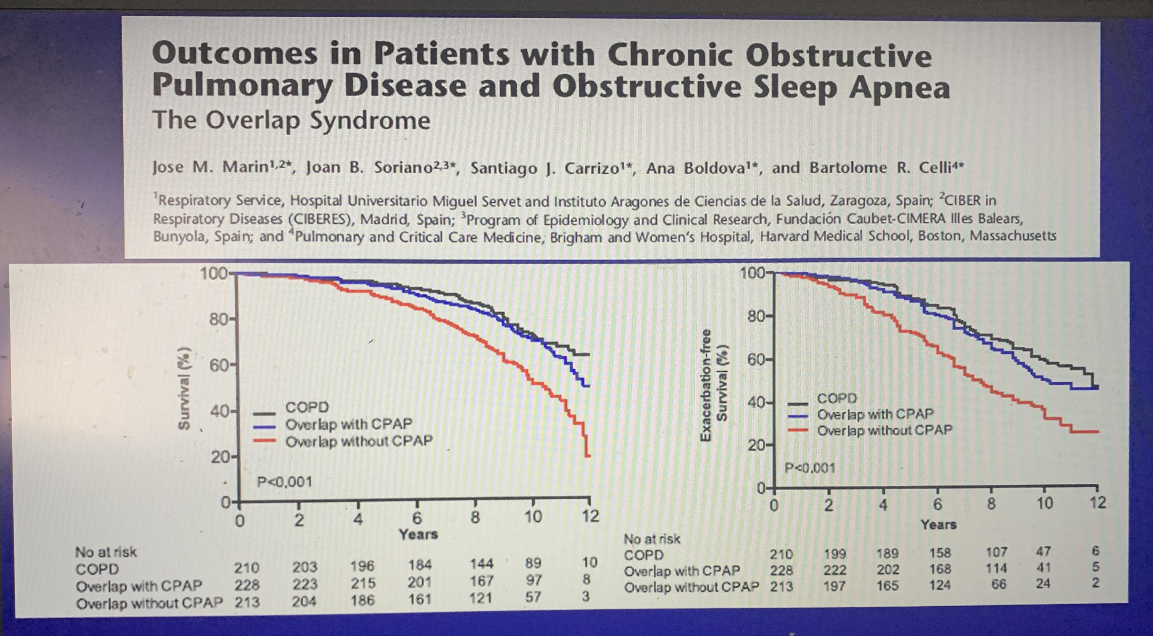
57 Marin JM, Soriano JB, Carrizo SJ, et al. Outcomes in patients with chronic obstructive pulmonary disease and obstructive sleep apnea: the overlap syndrome. Am J Respir Crit Care Med 2010; 182: 325–331.
“Clinical cohort studies indicate that exacerbation rate and mortality is reduced in subjects compliant with PAP treatment”
Prospective cohort in spain. Clasified by COPD w/o OSA, COPD w OSA not on CPAP, and COPD w OSA on CPAP. ~200 patients each
K-M curves / proportional hazard for mortality and time w/o exacerbation.
Higher comorbidity burden in OVS; increased mortality and exacerbations in the untreated OVS group compared to COPD and treated OVS.
Critique: receipt not randomized, CPAP likely marker for are healthcare behaviors.

Slide 31
Machado MC, Vollmer WM, Togeiro SM, Bilderback AL, Oliveira MV, Leitão FS, Queiroga F Jr, Lorenzi-Filho G, Krishnan JA: CPAP and survival in moderate-to-severe obstructive sleep apnoea syndrome and hypoxaemic COPD. Eur Respir J 2010, 35(1):132–137.
Machado et al DOI: 10.1183/09031936.00192008 , CPAP treated with 71% survival vs 26% in untreated in LTOT COPD clinic in Brazil. Adjusted HR 0.19 (0.08-0.48)
Implausibly large treatment effect. – also, not large enough for that many predictors?
All needed oxygen for more than 6 months.
95 patients diagnosed with OVS; 61 treated+adherent to CPAP, 34 not. Not treated were older, more exacerbations. Multivariable model controlled for spiro, BMI, smoking hx, hosp, CCI, noct hypoxemia.

Slide 32
Krishna suggested revision review:
While the cardiovascular and ventilatory control aspects have been highlighted, a third aspect is the direct effect of intermittent hypoxia on airway inflammation and risk of exacerbations. This may be the most relevant to the clinician if OSA treatment can reduce the frequency of exacerbations, degree of dyspnea or other COPD related symptoms.
Intermittent hypoxemia – airway inflammation (CRP, IL6 NFKB-TNFalpha, IL-8) and ROS may both contribute to exacerbations.

Slide 33
He BT, Lu G, Xiao SC, et al. Coexistence of OSA may compensate for sleep related reduction in neural respiratory drive in patients with COPD. Thorax 2017;72:256–62.
NREM drive to breath assessed by Ve / EMGdi ratio in overlap syndrome against COPD alone, OSA alone, and healthy subjects. (n=16,19,14,12 each)
Ve decreased 10% in healthy, 24% in COPD, 21% in OSA, and 27% in OVS
Drive: decreased in COPD (20-30%), increased in OSA (in response to upper airway resistance), and remained unchanged on OVS (cancelled).
Thus, OVS may be protective against sleep hypoventilation?
ETCO2 similar between OVS and OSA - either deadspace increased in OVS or apneas/hypopneas were less consequential (traction?) – OVS had mostly hypopneas
Critique: no matching for disease or severity symptoms – are these differences in pathophysiology, or reflection of what conditions are often present at the diagnosis of sleep complaints?
Notes:
OSA and COPD – interact in complex, sometimes competing or self-canceling ways.
Of note, hypopnea definition (in terms of SpO2 desaturation) is probably more sensitive and less specific to a threshold of disease severity in COPD patients due to gas-exchange abnormaliies.
-commentary Laghi F, Owens RL. Thorax March 2017 Vol 72 No 3
Synthesis: in addition to the issue of tracheal traction, COPD and OSA may have competing effects on the drive to breath, with OSA increasing airway resistance and protecting against sleep hypoventilation. OVS, thus has been found to occupy a middle ground.
Neural drive to breath is known to decrease at night in patients with COPD
AHI definition does not adequately capture the varying hypoventilation, or that hypopneas – which are defined on the basis of desaturation – are more likely to occur in patients with gas-exchange abnormalties.
Smoking as shared risk factor
Additionally, across the spectrum some pathophysiology may be synergistic (predisposition to hypoxemia), some may be subtractive (tracheal traction from emphysema, apposing effects on nocturnal drive to breathe) and some may be unrelated (sleep disruption). Exactly how the two disorders interact may vary by disease severity of each,
REM atonia of the voluntary, skeletal muscles.

Slide 34
Stanchina ML, Welicky LM, Donat W, et al. Impact of CPAP use and age on mortality in patients with combined COPD and obstructive sleep apnea: the overlap syndrome. J Clin Sleep Med 2013;9: 767–72 PMID: 23946706
10272 outpatients with OSA or COPD diagnostic codes -> 1,112 COPD and 2284 OSA confirmed; 227 overlap patients.
In multivariate analysis / Cox-regression of OVS, CPAP use (HR 0.71 per hour used in the first 1-3 months) and Age (1.14 per decade) independently associated with risk of mortality
No independent association with other factors (FEV1, Supplemental O2, active smoking, or comorbidity index) was found.
Observational

Slide 35
Adler D, Bailly S, Benmerad M, Joyeux-Faure M, Jullian-Desayes I, Soccal PM, Janssens JP, Sapène M, Grillet Y, Stach B, Tamisier R, Pépin JL. Clinical presentation and comorbidities of obstructive sleep apnea-COPD overlap syndrome. PLoS One. 2020 Jul 9;15(7):e0235331. doi: 10.1371/journal.pone.0235331. PMID: 32645005; PMCID: PMC7347183.
National Registry in France, patient referred for suspected SDB. OVS (FEV1/FVC < 0.7, n=2098) vs OSA (AHI 15+, FEV1/FVC > 0.7 n=14368) alone. (All smokers get spiro as part of their workup, supposedly)
Same BMI; More hypercapnia in OVS, lower oxygen
More comorbidities of all sorts in OVS group, less sleepiness at the wheel.
In regressions: older age (they used fixed cutoff). PVD, alcohol, smoking, age, and male gender all independently associated. For example, HTN and stroke not independently associated.
“Associations between COPD and CV in OSA patients; causality needs to be firmly established by incident data and RCTs"
Notes:
Authors state: OSA is less symptomatic in COPD patients – assessment of lung function may predict better than traditional screening. Citations 10-12
10. Adler D, Dupuis-Lozeron E, Janssens JP, Soccal PM, Lador F, Brochard L, et al. Obstructive sleep
apnea in patients surviving acute hypercapnic respiratory failure is best predicted by static hyperinflation.
PloS one. 2018; 13(10):e0205669. https://doi.org/10.1371/journal.pone.0205669 PMID: 30359410
11. Soler X, Liao S-Y, Marin JM, Lorenzi-Filho G, Jen R, DeYoung P, et al. Age, gender, neck circumference,
and Epworth sleepiness scale do not predict obstructive sleep apnea (OSA) in moderate to
severe chronic obstructive pulmonary disease (COPD): The challenge to predict OSA in advanced
COPD. PloS one. 2017; 12(5):e0177289. https://doi.org/10.1371/journal.pone.0177289 PMID:
28510598
12. Krachman SL, Tiwari R, Vega ME, Yu D, Soler X, Jaffe F, et al. Effect of Emphysema Severity on the
Apnea–Hypopnea Index in Smokers with Obstructive Sleep Apnea. Annals of the American Thoracic
Society. 2016; 13(7):1129–35. https://doi.org/10.1513/AnnalsATS.201511-765OC PMID: 27078132
→ More hypopneas? Definition is more sensitive for apneas
Risk of heart failure: citation 13-16
13. Chaouat A, Weitzenblum E, Krieger J, Ifoundza T, Oswald M, Kessler R. Association of chronic obstructive
pulmonary disease and sleep apnea syndrome. Am J Respir Crit Care Med. 1995; 151(1):82–6.
https://doi.org/10.1164/ajrccm.151.1.7812577 PMID: 7812577
14. Weitzenblum E, Chaouat A, Kessler R, Canuet M. Overlap syndrome: obstructive sleep apnea in
patients with chronic obstructive pulmonary disease. Proc Am Thorac Soc. 2008; 5(2):237–41. https://
doi.org/10.1513/pats.200706-077MG PMID: 18250217
15. McNicholas WT. COPD-OSA Overlap Syndrome: Evolving Evidence Regarding Epidemiology, Clinical
Consequences, and Management. Chest. 2017; 152(6):1318–26. https://doi.org/10.1016/j.chest.2017.
04.160 PMID: 28442310
16. McNicholas WT. Does Associated Chronic Obstructive Pulmonary Disease Increase Morbidity and
Mortality in Obstructive Sleep Apnea?: American Thoracic Society; 2019.
Increased systemic inflammation, oxidative stress, sympathetic overactivity, and endothelial overactivation.
Vernooy JH, Ku¨c¸u¨kaycan M, Jacobs JA, Chavannes NH, Buurman WA, Dentener MA, et al. Local and
systemic inflammation in patients with chronic obstructive pulmonary disease: soluble tumor necrosis
factor receptors are increased in sputum. American journal of respiratory and critical care medicine.
2002; 166(9):1218–24. https://doi.org/10.1164/rccm.2202023 PMID: 12403691
18. Ryan S, Taylor CT, McNicholas WT. Selective activation of inflammatory pathways by intermittent hypoxia
in obstructive sleep apnea syndrome. Circulation. 2005; 112(17):2660–7. https://doi.org/10.1161/
CIRCULATIONAHA.105.556746 PMID: 16246965
19. Ryan S, Taylor CT, McNicholas WT. Predictors of elevated nuclear factor-κB–dependent genes in
obstructive sleep apnea syndrome. American journal of respiratory and critical care medicine. 2006;
174(7):824–30. https://doi.org/10.1164/rccm.200601-066OC PMID: 16840748
Increased risk of CV disease in OVS 21, 22, 41-43
21. Putcha N, Crainiceanu C, Norato G, Samet J, Quan SF, Gottlieb DJ, et al. Influence of lung function and
sleep-disordered breathing on all-cause mortality. A community-based study. American journal of respiratory
and critical care medicine. 2016; 194(8):1007–14. https://doi.org/10.1164/rccm.201511-2178OC
PMID: 27105053
22. Kendzerska T, Leung RS, Aaron SD, Ayas N, Sandoz JS, Gershon AS, et al. Cardiovascular Outcomes
and All-Cause Mortality in Patients with Obstructive Sleep Apnea and Chronic Obstructive Pulmonary
Disease (Overlap Syndrome). Annals of the American Thoracic Society. 2018(ja).

Slide 36
Toraldo DM, De NF, Nicolardi G. Fixed-pressure nCPAP in patients with obstructive sleep apnea (OSA) syndrome and chronic obstructive pulmonary disease (COPD): a 24-month follow-up study. Sleep Breath 2010;14:115–23. PMID: 19756803
12 patients BMI 30+ with diagnosis of COPD not on LTOT; 1 center in Italy. Avg FEV1 60% predicted (moderate obstruction), BMI 34.2, severe OSA (43)
Starting auto nCPAP; followed for 2 years. Mean use 5 hours per night. Assessed at 3, 12, and 24 months.
All changes occurred within 3 months (excessive normalization of sleepiness): FEV1, FRC, mPAP, CO2, PaO2 (daytime), as well as sleep measures (hypox and AHI)
No control group
Also reported pre-post hospitalization though the data is not believable.

Slide 37
As previously covered, OVS can lead to hypercapnia. Comparison between OVS and OHS comorbidities paper?

Slide 38
DOI: 10.7759/cureus.3453 [ ] cite this with the CHEST review
Several observational studies have demonstrated reduced risk of exacerbations and death in patients with overlap syndrome who accept and adhere to CPAP treatment. How much of this effect results from effects of CPAP versus as a marker for health-related behaviors cannot be determined from the existing literature.
Also cite: Owens RL, Malhotra A. Sleep-disordered breathing and COPD: the overlap syndrome. Respiratory care. 2010 Oct 1;55(10):1333-46. as a review.

Slide 39
Health-related quality of life in patients with obstructive sleep apnoea and chronic obstructive pulmonary disease (overlap syndrome) C. Mermigkis, doi: 10.1111/j.1742-1241.2006.01213.x
75 patients with COPD, stable outpatient, +snoring but no EDS (ie. would not meet traditional screens)
30 had OSA;
Compared to 15 matched (demo, spiro, abg) controls
St George’s respiratory questionnaire: OVS > Symptoms, activity and impact scores.
Sleep architecture similar; oxygen desaturation similar
Notes:
Takeaway: In patients with COPD, OSA often doesn’t cause sleepiness but DOES contribute to reduced quality of life.

Slide 40
CPAP vs BiPAP (or NIV)? JCSM study
However, one study that found benefit from NIV in hypercapnic COPD may have included overlap-syndrome patients.108,109
108. Gay PC. Chronic obstructive pulmonary disease and sleep. Respir Care. 2004; 49(1):39–51. [PubMed: 14733621]
109. Meecham Jones DJ, Paul EA, Jones PW, Wedzicha JA. Nasal pressure support ventilation plus oxygen compared with oxygen therapy alone in hypercapnic COPD. Am J Respir Crit Care Med. 1995; 152(2):538–544. [PubMed: 7633704]

Slide 41
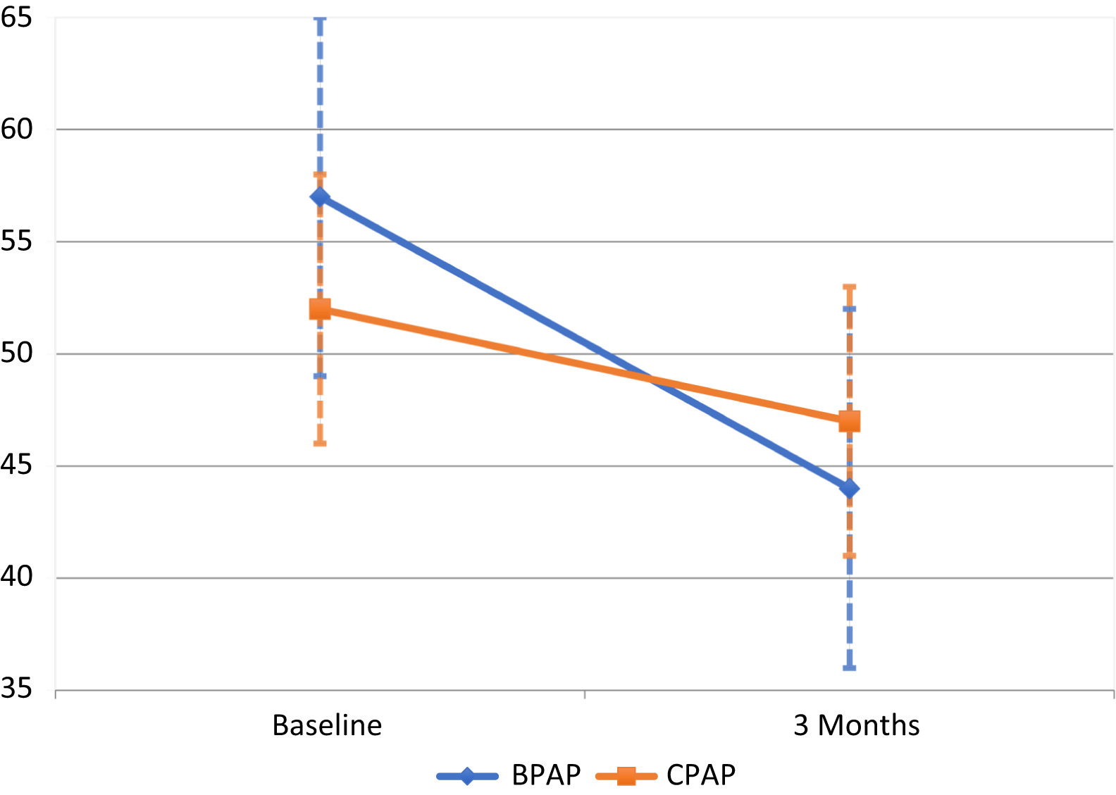
https://jcsm.aasm.org/doi/10.5664/jcsm.9506
Prior lit: OHS lit excludes COPD, COPD lit excludes OHS. What to do with both?
N= 32 stable outpatients with chronic hypercapnic respiratory failure and concurrent obesity and COPD (req: PaCo2 over 45, bmi over 30, FEV1/FVC < 0.7, not on pap). Randomized; single blinded
BiPAP-S more effective at reducing PaCO2 than CPAP over 3 months; also increasing FEV1
Though no difference in functioning
Small driving pressure (6) compared to COPD lit.

Slide 42
Re: Marin study (PMID: 20378728) – “Even when adjusted for COPD severity, comorbid OSA remained a risk factor for death.”
In the observational study by Marin, death in the untreated overlap group was most commonly attributed to cardiovascular disease.70
Again, CPAP was not provided in a randomized, blinded manner, but markers of both COPD and OSA severity were similar in the CPAP-treated and untreated groups.
Platt AB, Kuna ST, Field SH, et al. Adherence to sleep apnea therapy and use of lipid-lowering drugs: a study of the healthy-user effect. Chest. 2010; 137(1):102–108. [PubMed: 19820075]
Martha E. Billings, MD, Dennis Auckley, MD, Ruth Benca, MD, Nancy Foldvary-Schaefer, DO, Conrad Iber, MD, Susan Redline, MD, Carol L. Rosen, MD, Phyllis Zee, MD, Vishesh K. Kapur, MD, MPH, Race and Residential Socioeconomics as Predictors of CPAP Adherence, Sleep, Volume 34, Issue 12, 1 December 2011, Pages 1653–1658, https://doi.org/10.5665/sleep.1428
Marin 2005 (PMID: 15781100) Also looked at CPAP vs No CPAP (similar methodology, 10y follow-up) in all comers with mortality. Found a 2x increased risk of fatal CV event death compared to those who accepted treatment.
Yet, meta-analysis (PMID: 30736888) of 4 RCTs (n=1898) followed for 3-5 years = RR 0.96 (0.84-1.11) for mortality
Same meta-analysis for all cause CV events 6 RCTs (n=2188) = RR 0.96 (0.76 – 1.21) for CV events.

Slide 43
Pathogenesis of obstructive sleep apnea in individuals with the COPD + OSA Overlap syndrome versus OSA alone Physiological Reports. 2020;8:e14371. https://doi.org/10.14814/phy2.14371
OSA pathogenicity:
Anatomic factors: upper airway collapsibility (may stiffen when lung is hyper-inflated, but emphysema loss of elastic recoil may lessen this – hard to know a priori)
Neurologic / Physiologic factors: upper airway muscle response (worsened by ICS? Smoking?), respiratory-related arousability from sleep (may be lower in OVS due to frequent awakenings in the absence of upper airway collapse), control of breathing (respiratory drive generally increased)
Matched OSA (n=15) to OVS (n=15; most with moderate obstruction) on gender, age, BMI. Exclude: narcotics, sedatives, supp O2, recent exacerbation, BMI over 36, active smoking, heavy EtOH
PSG to determine Veupnea, Vpassive and Pcrit, Varousal/ArTh, Loop gain
“Consistent differences in key OSA traits were not observed between OVS and OSA alone.”. OVS: lower sleep efficiency, REM SpO2
Reduced upper airway response in those with air trapping; increased loop gain in those with worse airflow obstruction (contrary to expection; perhaps mediated by hypoxemia?). Somewhat lower arousal threshold – perhaps explains how hypercapnia can occur?
No difference in collapsibility: perhaps this is selection – if you have to have dx of OSA, then by definition the airway must be collapsable
Notes:
“
Veupnea: Ventilation during sleep in the absence of upper
airway obstruction (i.e., on therapeutic CPAP pressure),
such that ventilation should match baseline ventilatory
drive.
Vpassive and Pcrit: Both are measures of collapsibility of
the upper airway, determined at baseline ventilatory
drive (i.e., without accumulation of any additional drive
that might result from prolonged upper airway obstruction).
Vpassive measures ventilation at atmospheric pressure
(zero cm H2O) under such nonactivated airway
conditions, while Pcrit measures the pressure at which
inspiratory flow goes to zero under nonactivated airway
conditions.
Varousal and Ventilatory arousal threshold (ArTh): Both are
measures of the tendency to wake from sleep due to inspiratory
flow limitation. Varousal measures the minimum
ventilation that can be sustained without arousal during
steady-state conditions. Ventilatory drive accumulates
under such conditions, leading to increases in intrathoracic
pressure swings; a high Varousal indicates a tendency
to wake up with minimal increase in intrathoracic pressure
swings. The ArTh is a calculated value, using the LG and
Veupnea data to estimate the ventilatory drive that is present
at the ventilation measured by Varousal.
Vactive and Upper airway gain (UAG): Both are measures
of the ability of the upper airway to dilate in response to
increases in respiratory drive. Vactive measures ventilation
at atmospheric pressure (zero cm H2O) under maximally
tolerated increased respiratory drive (i.e., at the same
point in drive as Varousal and ArTh). The UAG is a calculated
value, using Vpassive, Vactive, Veupnea, and LG to determine
the increase (or decrease) in ventilation achieved
using an increase in respiratory drive.
Loop Gain (LG): Measures instability in ventilatory control,
by measuring the ratio of ventilatory response to a
steady-state ventilatory disturbance. The disturbance is
the increase in drive that results from steady-state inspiratory
flow limitation conditions, and response is determined
by suddenly alleviating the flow limitation.

Slide 44
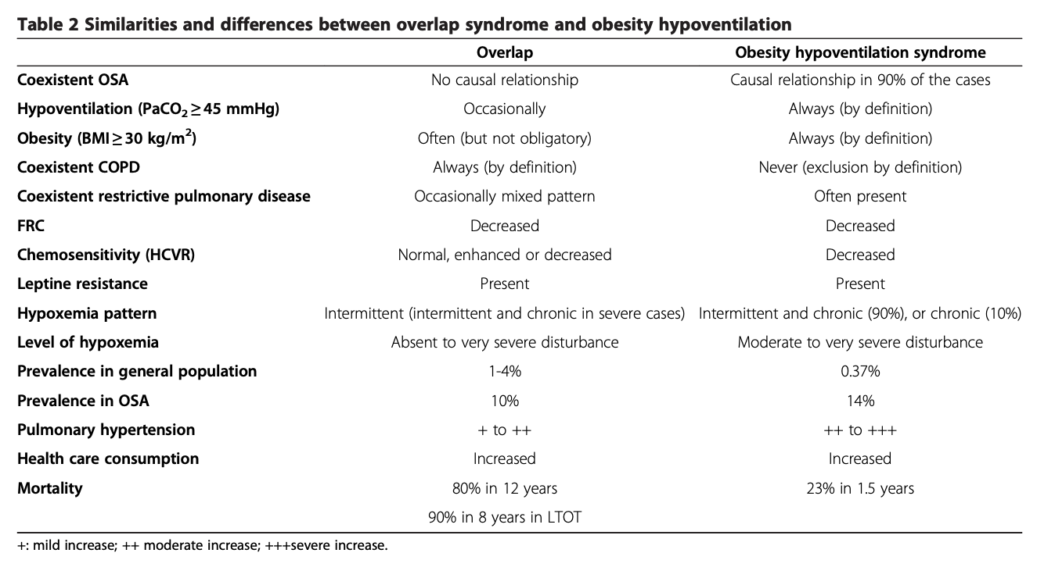
Differentiating OVS and OHS
doi:10.1186/1465-9921-14-132 Cite this article as: Verbraecken and McNicholas: Respiratory mechanics and ventilatory control in overlap syndrome and obesity hypoventilation. Respiratory Research 2013 14:132.
https://link.springer.com/content/pdf/10.1186/1465-9921-14-132.pdf
Notes:
Are they diff? However, they are also quite distinct from each other in a sense that obesity is not always present in overlap syndrome, and chemical drive can be preserved, while OSA is not always present in obesity hypoventilation, and COPD is an exclusion criterion in the definition of OHS.
Meta-analysis on factors on predicting OSA in COPD
➔ https://doi.org/10.1016/j.smrv.2016.10.004
From above citation:
“Chronic daytime hypercapnia would emerge if both the acute ventilatory compensation for transient nocturnal hypercapnia is compromised, as well as the bicarbonate excretion, as might be seen under condition of hypoxia (f.i. chest infection), diuretic therapy, or heart failure [170,178]. This makes both patient categories more susceptible to acute ventilatory failure [126]. Despite this, the diagnosis of overlap syndrome and of OHS appears to be often overlooked, especially in a clinical setting when dealing with the other illnesses of these patients [189].
“
In subjects with chronic hypercapnia, there is an increased blood bicarbonate concentration, which may inhibit the ventilatory response to CO2 and decreases mouth occlusion pressure response during wakefulness and sleep [50]. When normocapnic, overlap patients can however have a normal or even enhanced ventilatory response to CO2 [51]. This is in contrast to the data on decreased hypercapnic (HCVR) and hypoxic (HVR) ventilatory response in OHS, as compared to obese, non-hypercapnic subjects [52].
Hypoxemia and hypercapnia are however less severe in patients with overlap than in patients with OHS [54].
Effectively, daytime hypercapnia is more common in overlap syndrome as compared to simple OSA [23]. However, a correlation between hypercapnia and the frequency and duration of respiratory events during the night could not be observed [72,73].
23 Bradley TD, Rutherford A, Lue F, Moldofsky H, Grossmann RF, Zamel N, Phillipson EA: Role of diffuse airway obstruction in the hypercapnia of obstructive apnea. Am Rev Respir Dis 1986, 134:920–924.
50 Radwan L, Maszczyk Z, Koziorowski A, Koziej M, Cieslicki J, Sliwinski P, Zielinski J: Control of breathing in obstructive sleep apnoea and in patients with the overlap syndrome. Eur Respir J 1995, 8:542–545
51 Verbraecken J, De Backer W, Willemen M, De Cock W, Wittesaele W, Van de Heyning P: Chronic CO2 drive in patients with obstructive sleep apnea and effect of CPAP. Respir Physiol 1995, 101:279–287.
52 Zwillich CW, Sutton FD, Pierson DJ, Greagh EM, Weil JV: Decreased hypoxic ventilatory drive in the obesity hypoventilation syndrome. Am J Med 1975, 59:343–348.
54 Kessler R, Chaouat A, Schinkewitch P, Faller M, Casel S, Krieger J, Weitzenblum E: The obesity-hypoventilation syndrome revisited: a prospective study of 34 consecutive cases. Chest 2001, 120:369–376
72 Garay SM, Rapoport D, Sorkin B, Epstein H, Feinberg I, Goldring RM: Regulation of ventilation in the obstructive sleep apnea syndrome. Am Rev Respir Dis 1981, 124:451–457.
73 Lopata M, Onal E: Mass loading, sleep apnea, and the pathogenesis of obesity hypoventilation. Am Rev Respir Dis 1982, 126:640–645.

Slide 45
Obesity – Airway disease missed dx
Veterans (5000) in PNW - DOI: 10.1378/chest.13-2759
BMI category increase = reduced likelihood of airflow limitation
In each higher category, likelihood of an inappropriate diagnostic label increased as did likelihood of being started (and remaining a year later) on inhalers, inappropriately.
Gershon and colleagues studied the healthcare burden of COPD overdiagnosis and demonstrated that individuals with overdiagnosed COPD had 89% higher rates of hospitalizations, 42% higher rates of emergency department visits, and 52% higher rates of ambulatory care visits compared with people without COPD after adjustment for age and sex (10).
Notes:
10 - Martinez CH, Mannino DM, Jaimes FA, Curtis JL, Han MK, Hansel NN, et al. Undiagnosed obstructive lung disease in the United States: associated factors and long-term mortality. Ann Am Thorac Soc 2015;12:1788–1795.
Narrative review - https://www.atsjournals.org/doi/10.1164/rccm.201804-0621CI
Scoping review of missed diagnosed of COPD appendix summarizing - https://www.resmedjournal.com/action/showFullTableHTML?isHtml=true&tableId=undtbl1&pii=S0954-6111%2817%2930157-9
Why important? Similar to other studies, a large proportion of patients were misdiagnosed as having COPD or left heart failure and likely received inappropriate therapy (including systemic steroids and inhalers)
(36). - Collins BF, Ramenofsky D, Au DH, Ma J, Uman JE, Feemster LC. The association of weight with the detection of airflow obstruction and inhaled treatment among patients with a clinical diagnosis of COPD. Chest 2014;146:1513‐1520.
“dyspneic obese patients are frequently misdiagnosed with asthma or COPD
and treated with inappropriate pharmacologic agents (37).”
Sin DD, Jones RL, Man SF. Obesity is a risk factor for dyspnea but not for airflow obstruction. Arch Intern Med 2002;162:1477‐1481.

Slide 46
Overlap syndrome diagnostic performance
Similar to other studies, a large proportion of patients were misdiagnosed as having COPD or left heart failure and likely received inappropriate therapy (including systemic steroids and inhalers)
(36). - Collins BF, Ramenofsky D, Au DH, Ma J, Uman JE, Feemster LC. The association of weight with the detection of airflow obstruction and inhaled treatment among patients with a clinical diagnosis of COPD. Chest 2014;146:1513‐1520.
“dyspneic obese patients are frequently misdiagnosed with asthma or COPD
and treated with inappropriate pharmacologic agents (37).”
Sin DD, Jones RL, Man SF. Obesity is a risk factor for dyspnea but not for airflow obstruction. Arch Intern Med 2002;162:1477‐1481.
Notes:
“Questionnaires to screen and determine the probability of OSA, such as the Epworth Sleepiness Scale, the STOP BANG or the Berlin questionnaire, have not been specifically validated for patients with coexisting COPD and should therefore be used with some caution [41]. Specific sleep-related questionnaires for COPD patients have been developed but clinical experience is limited [42, 43].”
41 Faria AC, da Costa CH, Rufino R. Sleep Apnea Clinical Score, Berlin Questionnaire, or Epworth Sleepiness Scale: which is the best obstructive sleep apnea predictor in patients with COPD? Int J Gen Med 2015; 8: 275–281.
42 Soler X, Liao SY, Marin JM, et al. Age, gender, neck circumference, and Epworth sleepiness scale do not predict obstructive sleep apnea (OSA) in moderate to severe chronic obstructive pulmonary disease (COPD): the challenge to predict OSA in advanced COPD. PLoS One 2017; 12: e0177289.

Slide 47
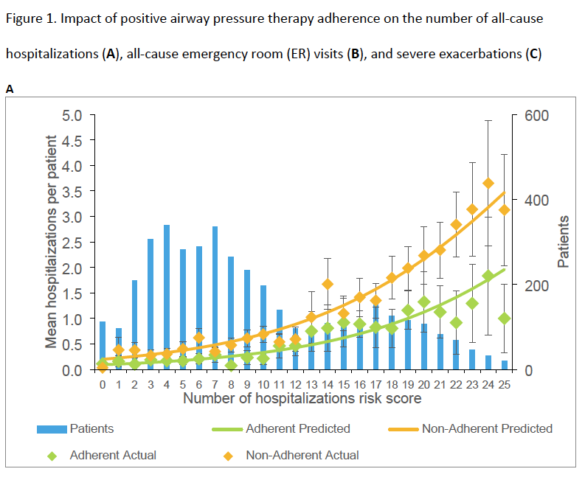
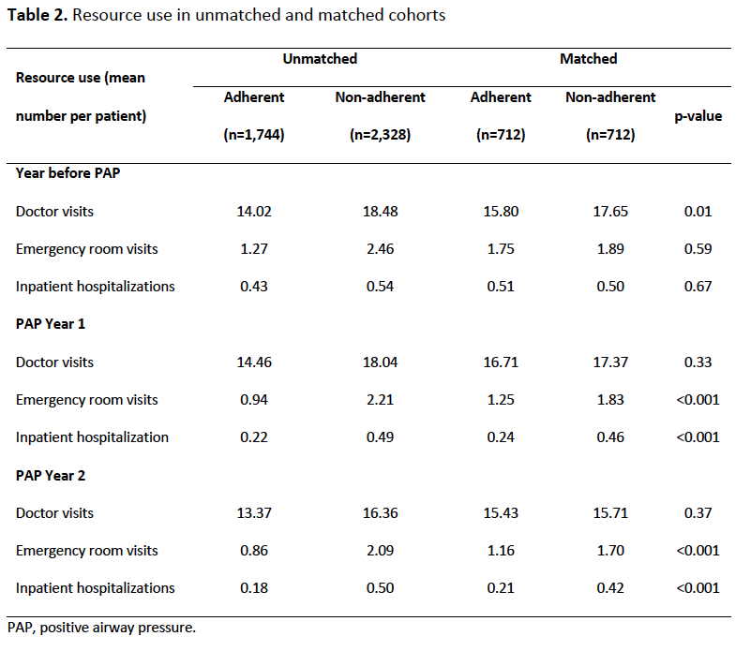
Sterling et al 2022 AJRCCM - https://www.atsjournals.org/doi/abs/10.1164/rccm.202109-2035OC
Proprietary database (https://www.inovalon.com/solutions/insights/) linked to Resmed adherence data
Propensity matched Model with comorbidities suggests health outcomes including expenditures, admission rates are lower in patients adherent to PAP
Size of reduction comparable to triple inhaler therapy (slightly larger)
Pre data is similar; confounding possible though not egregious
Notes:
Köhnlein et al. (42) published a randomized trial showing a mortality benefit in patients
with hypercapnic COPD treated with bi-level PAP therapy compared with usual care. However,
sleep studies were not systematically conducted in that study and therefore the potential
benefits of treating COPD versus treating overlap syndrome versus treating hypercapnic
respiratory failure remained unclear. Murphy et al. found that treatment with bi-level PAP was
effective for preventing exacerbations in patients with COPD (43). However, again sleep was
not systematically assessed and thus the benefits of treating overlap syndrome versus COPD
are unclear. Our findings confirm the benefits seen in studies by Marin et al. (18) and Stanchina
et al (20), both of which reported a reduction in mortality associated with PAP-treatment for
patients with overlap syndrome, and extend the findings to other important outcomes
including hospitalization and ER visits in a nationally representative population. We are not
aware of any randomized trials to date that have investigated therapy for overlap syndrome.

